Slide 1
Linux File System
By-
Aishwarya Kenchannavar - 2GI20CS007
Anisha Sangolli - 2GI20CS014
Devaki Prabhu - 2GI20CS036
Divyani Kumbar - 2GI20CS040

Slide 2
Linux Download And Installation
Virtual Machine used – Oracle Virtual Box version 6.0
The Oracle VirtualBox is a platform that allows user to run multiple operating systems on the same hardware.
Operating system used – Linux CentOS
The installation program that Cent OS uses is known as Anaconda.
VDI is the recommended hard disk file type to use when creating your first Oracle virtual machine.

Slide 3
INTRODUCTION TO UNIX/LINUX
The Unix operating system was created more than 30 years ago by a group of researchers at AT&T’s Bell Laboratories.
During the three decades of constant development that have followed, Unix has found a home in many places, from the mainframe to home computers to the smallest of the embedded devices.
Linux was first developed by Linux Torvalds in 1991.
No one owns Linux since it is open source and it is built as an mutual effort by those who are involved in Linux community.

Slide 4
INTRODUCTION TO LINUX FILE SYSTEM
LINUX FILE SYTEM
OS store data on disk drives using a structure called a filesystem, consisting of files, directories, and the information needed to access and locate them.
There are many different types of filesystems. In general, improvements have been made to filesystems with new release of operating systems, and each new filesystem has been given a different name.
E.g :- ext3, ext4, XFS etc.,
Linux filesystems store information in a hierarchy of directories and files.

Slide 5
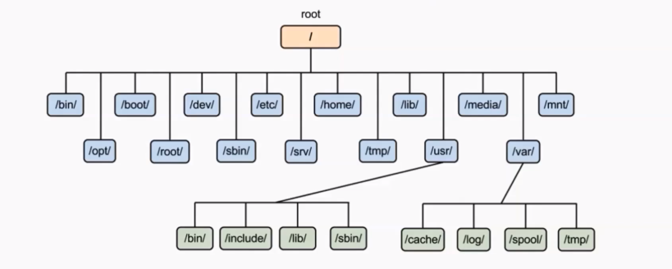
FILE SYSTEM STRUCTURE AND DESCRIPTION
/root root user home directory. It is not same as /
/dev System devices(e.g. disk, cdrom, speakers etc.,.
/etc Configuration files
/bin ->/user/bin Everyday user commands
/lib->usr/lib C Programming library files needed by commands and apps
/tmp Directory for temporary files
/home Directory for User

Slide 6
FILE SYSTEM NAVAGATION COMMANDS
NAVAGATION FILE SYSTEM
When navigating a UNIX filesystem, there are a few important commands.
“cd”
“pwd”
“ls”
“cd” stands for change directory. It is the primary command for moving you around the filesystem.
“pwd” stands for print working directory. It tells you where your current location is.
“ls” stands for list. It lists all the directories/files within current working directory.

Slide 7
FILE SYSTEM PATHS
FILE SYSTEM PATHS
There are two paths to navigate to a filesystem
Absolute Path
Realtive Path
An absolute path always begins with a “/”. This indicates that the path starts at the root directory. E.g : cd/var/log
A Relative path does not begin with a “/”. It identifies a location relative to your current position. E.g : cd var

Slide 8
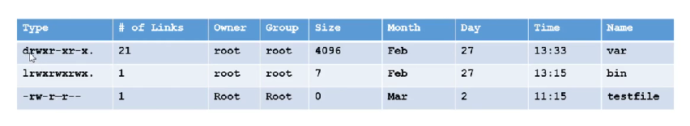
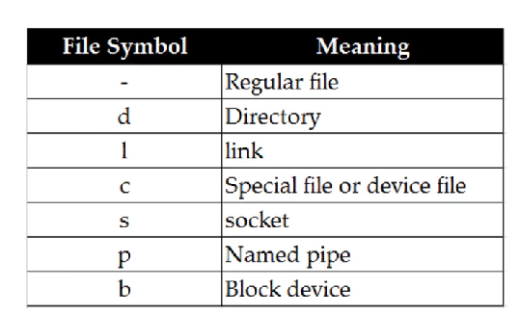
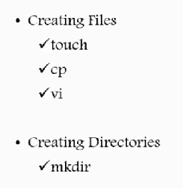
DIRECTORY LISTING ATTRIBUTES LINUX FILE TYPES CREATING FILES & DIRECTORIES

Slide 9
Find And Locate command
Difference between find and locate
Locate uses a prebuilt database, which should be regularly updated, while find iterates over a filesystem to locate files. Thus, locate is much faster than find, but can be inaccurate if the database (can be seen as a cache) is not updated.
To update locate database run updated.

Slide 10
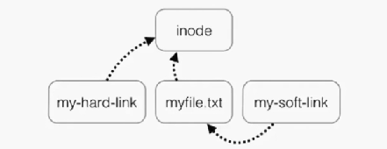
SOFT AND HARD LINKS
Inode = pointer or number of a file on the hard disk
Soft Link=Link will be removed if file is removed or renamed
Hard Link=Deleting renaming or moving the original file will not affect the hard link
ln
ln -s

Slide 11
WILDCARDS
A Wildcard is a character that can be used as a substitute for any of a class of characters in a search
* - represents Zero or more character
? - represents a single character
[ ] - represents a range of character

Slide 12
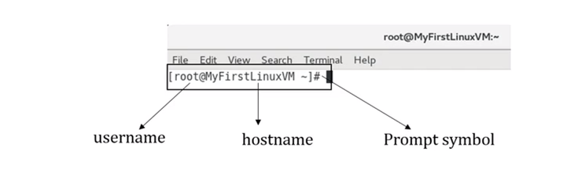
Command Prompts and Getting Prompts Back
What are command prompts ?
A command prompt, also referred to simply as a prompt, is a short text at the start of the command line followed by prompt symbol on a command line interface.

Slide 13
Linux Command Line
The Linux command line is a text interface to your computer. Often referred to as the shell, terminal, console, prompt or various other names, it can give the appearance of being complex and confusing to use.
Commands and Permissions:
Change Linux file permissions with the Linux chmod command, including chmod +rwx, chmod +x, chmod 777. The command for changing directory permissions for group owners is similar, but add a “g” for group or “o” for users:
chmod g+w filename.
chmod g-wx filename.
chmod o+w filename.
chmod o-rwx foldername.

Slide 14
Help Command and Pipes:
The 'help' command in Linux displays information about the shell built in commands. For example, to see the manual page for the 'cd' command, you can run 'help cd'.
Pipes in Linux allow you to redirect the output of one command to the input of another command. The pipe operator '|' is used for this purpose. For example, the command 'ls | grep .txt' will list all the '.txt' files in the current directory by first running the 'ls' command and then redirecting its output to the 'grep' command.

Slide 15
File Commands and Filters:
The Linux operating system provides several commands to manage files and directories:
ls - lists the files and directories in a directory
cd - changes the current working directory
cp - copies files and directories
mv - moves or renames files and directories
rm - removes files and directories
mkdir - creates a new directory
rmdir - removes an empty directory
touch - updates the modification time of a file or creates a new file
cat - concatenates and displays the contents of files
less - displays the contents of a file, one screen at a time etc.
Filters are programs that take plain text(either stored in a file or produced by another program) as standard input, transforms it into a meaningful format, and then returns it as standard output. Linux has a number of filters.

Slide 16
Text and Grep Command:
Text: is a sequence of characters and words that can be used to represent information, ideas and thoughts in a written or digital form. It is used in various forms such as documents, emails, articles and books.
Grep Command: is a command-line utility used for searching text files for lines that contain a specified pattern. It is an acronym for “Global Regular Expression Print”
grep [options] [pattern] [file(s)]
Options:
-i: Ignore case sensitivity
-v: Invert match (display non-matching lines)
-c: Count the number of matches
-l: Display only the filenames of files containing matches
-n: Display the line number of matches

Slide 17
File Comparison and Splitting:
File Comparison:
diff command: Compares two files and outputs the differences between them
cmp command: Compares two files byte by byte and outputs the first mismatch
md5sum command: Generates a checksum for a file and compares it with another file to check if they are identical
File Splitting:
split command: Divides a large file into smaller files
csplit command: Splits a file into sections determined by context lines

Slide 18
Utility Commands and User Management: Process Management and System Monitoring:
Utility commands are system-level commands that perform specific tasks, such as managing files, processes, or system settings.
User management involves creating, modifying, and deleting user accounts, as well as assigning permissions and setting password policies.
Process management is the task of managing the execution of processes in a computer system. This includes starting, stopping, suspending, and resuming processes, as well as monitoring their resource usage and performance.
System monitoring is the practice of monitoring various aspects of a computer system to ensure its proper functioning and identify performance bottlenecks and potential issues. This includes monitoring system resource utilization such as CPU, memory, disk, and network usage, as well as system logs and performance metrics.

Slide 19
Maintenance Commands and System Information:
Maintenance commands are used to perform routine tasks such as checking the file system, updating system packages, and backing up data. Examples of maintenance commands in Linux include:
'fsck' for checking and repairing file systems
'apt-get update' and 'apt-get upgrade' for updating system packages
'rsync' for backing up files and directories
System information commands in Linux are used to retrieve information about the hardware and software components of the system. Examples of system information commands in Linux include:
'uname' for displaying system information such as the kernel version and machine hardware name
'lsb_release' for displaying information about the Linux distribution
'lshw' for displaying detailed information about the system's hardware components

Slide 20
System Architecture and Commands:
System architecture refers to the design of a computer system, including both hardware and software components.
Examples of system architecture-related commands in Unix-like systems include:
'lscpu' for displaying information about the system's processor and architecture
'lshw' for displaying information about the system's hardware components
'dmidecode' for displaying information about the system's BIOS and hardware components
'lsmod' for displaying information about loaded kernel modules
'ifconfig' for configuring network interfaces.

Slide 21
THANK YOU

